Slide 1
Introduction to Convolutional Neural Network (CNN)
Gordon Gao
Carey Business School Professor

Slide 2
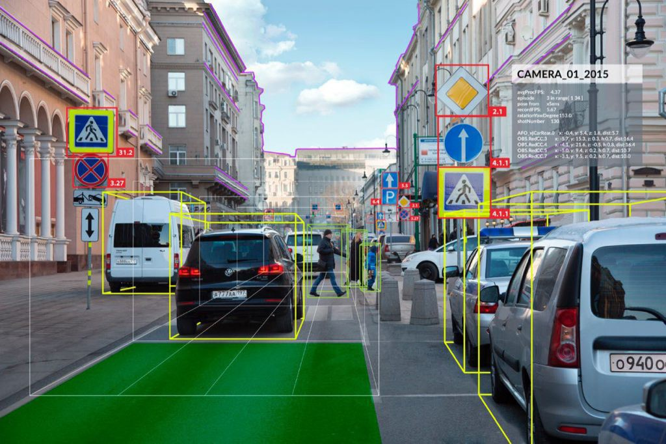

Slide 3

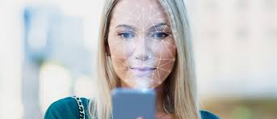

Slide 4
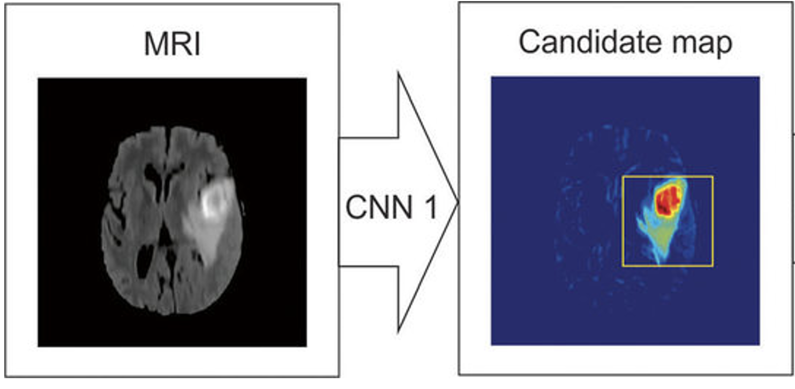
Notes:
CreditT1 - Deep Learning for Brain MRI Segmentation: State of the Art and Future Directions
VL - 30
DO - 10.1007/s10278-017-9983-4
JO - Journal of digital imaging

Slide 5
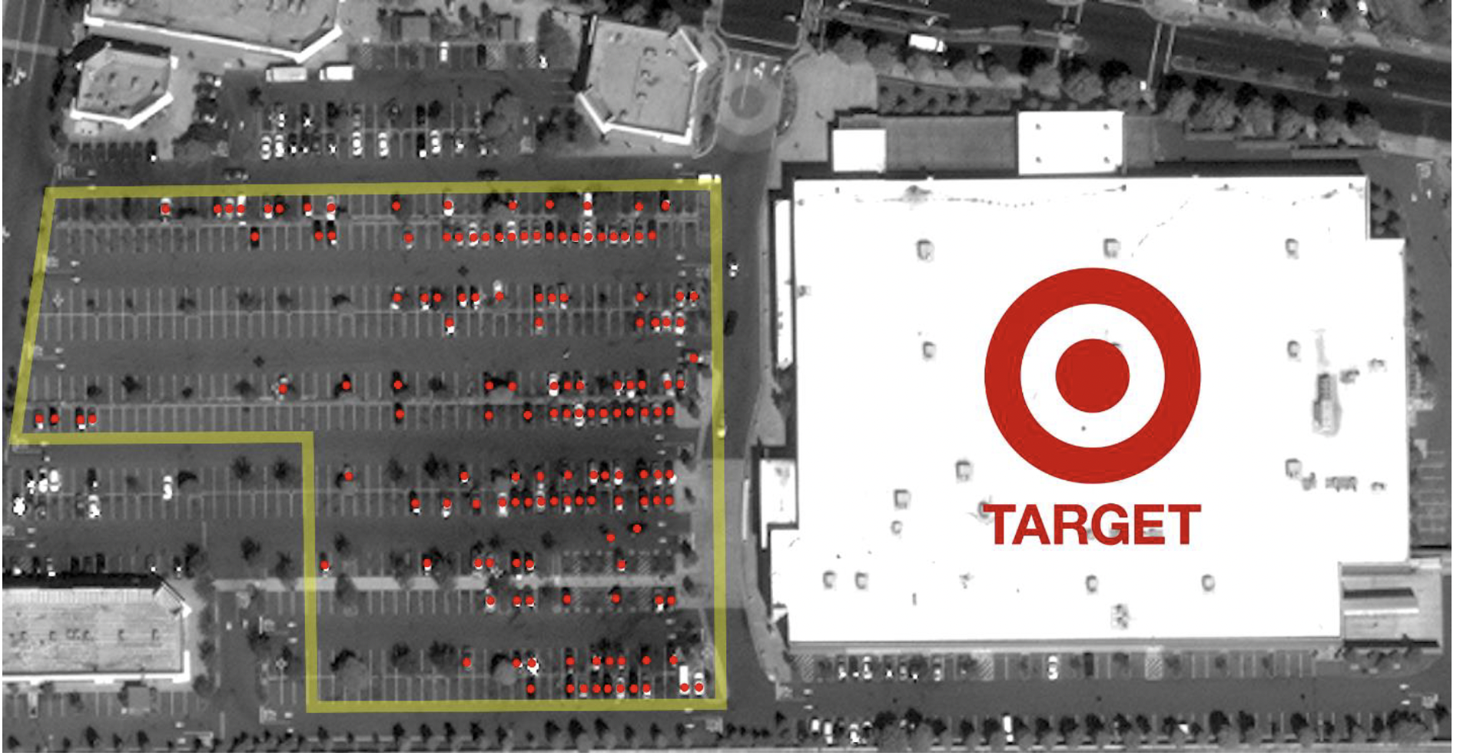
https://papers.ssrn.com/sol3/papers.cfm?abstract_id=3222741

Slide 6
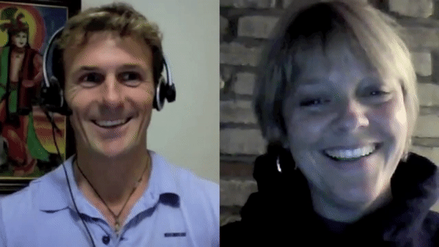
Coach
Patient

Slide 7
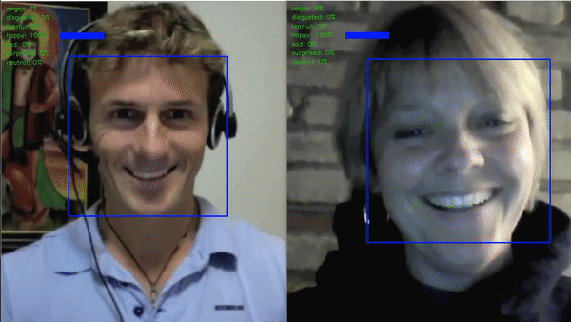
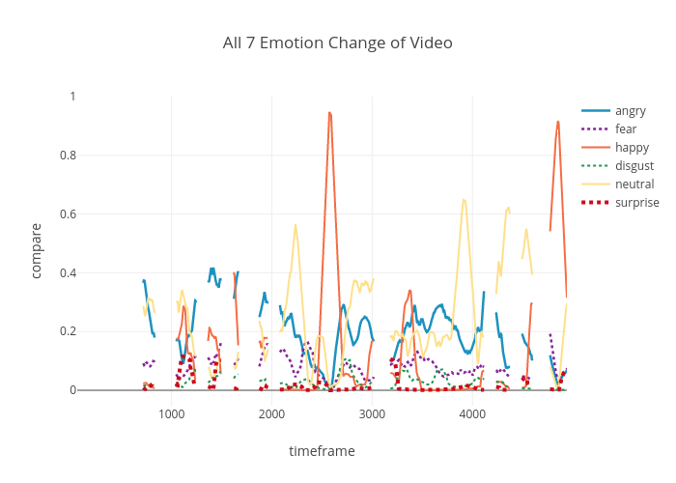
Implementation: Amazon Web Services (AWS)
CloudWatch
EC2 instance
S3 bucket
lambda function
$0.01 for a 30-minute session
Coach’s Fear
Patient Adherence

Slide 8
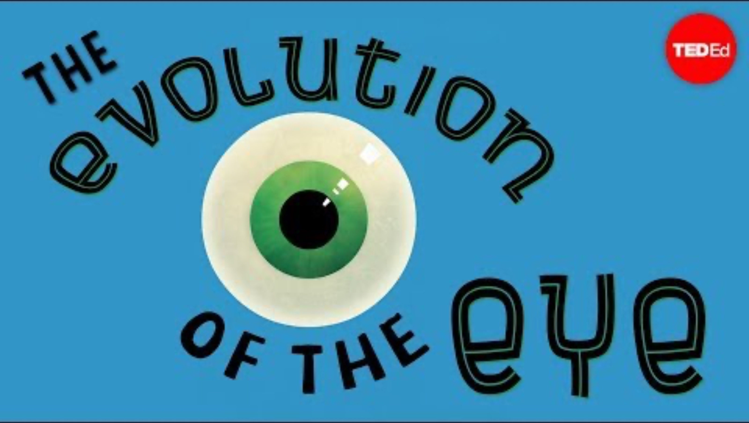

Slide 9
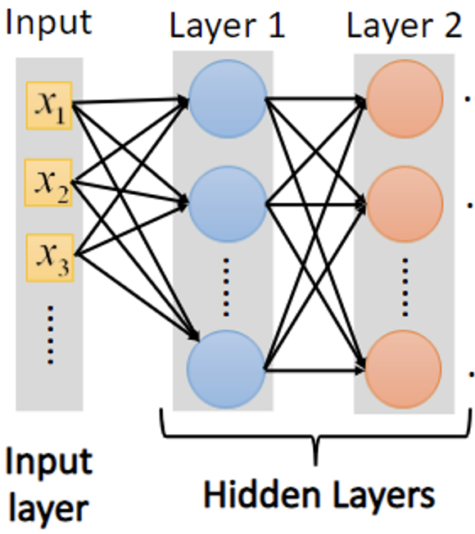
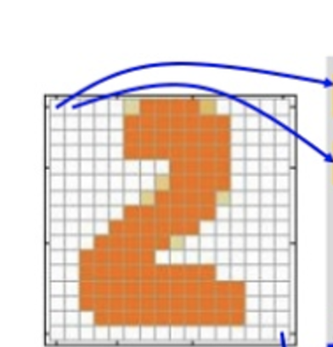
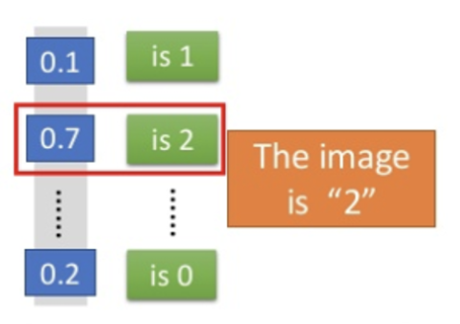
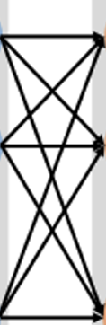
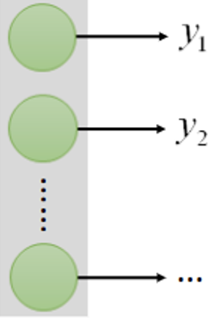
Handwritten digit recognition
Output
Pixels: 28 x 28 = 784
Output Layer

Slide 10

Convolutional Neural Network (CNN)

Slide 11
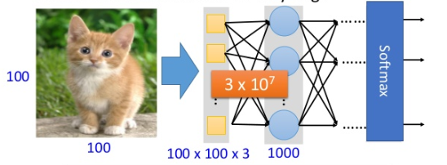
Challenges with images
When processing image, the first layer of fully connected network would be very large.

Slide 12
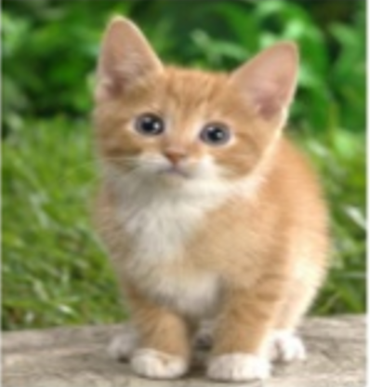
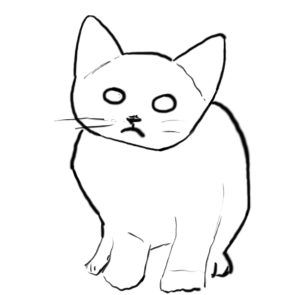

Slide 13
Shapes are made of edges
How to detect edges and shapes?
Convolution: sliding a filter across the image to match a pattern.
Filter is also called a kernel
The filter will produce a high value when a pattern is matched

Slide 14
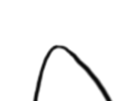
Filtering

Slide 15
CNN – Convolution
1 | -1 | -1
-1 | 1 | -1
-1 | -1 | 1
Filter 1
1 | 0 | 0 | 0 | 0 | 1
0 | 1 | 0 | 0 | 1 | 0
0 | 0 | 1 | 1 | 0 | 0
1 | 0 | 0 | 0 | 1 | 0
0 | 1 | 0 | 0 | 1 | 0
0 | 0 | 1 | 0 | 1 | 0
3
-1
-3
-1
-3
1
0
-3
-3
-3
0
1
3
-2
-2
-1
6 x 6 image
Credit: Hung-yi Lee

Slide 16
CNN – Max Pooling
3
-1
-3
-1
-3
1
0
-3
-3
-3
0
1
3
-2
-2
-1

Slide 17
Convolution + Max Pooling
Patterns in images are called features
Features that help us identify a cat.
Filter feature map
On the feature map, big value means a feature is matched, or detected
We will collect the high values on the feature map, and ignore the low values. This is called max pooling.
Convolution

Slide 18
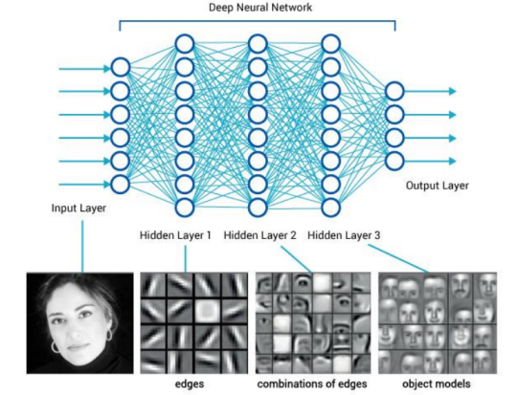
Why multiple convolutional layers

Slide 19
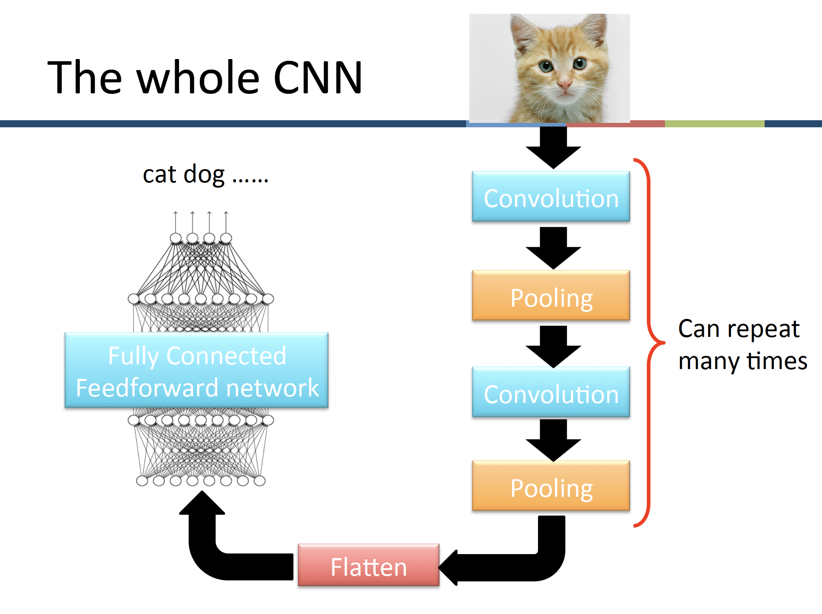

Slide 20

Panda into Gibbon
Source: https://www.technologyreview.com/2019/05/19/135299/how-we-might-protect-ourselves-from-malicious-ai/
Notes:
https://www.technologyreview.com/2019/05/19/135299/how-we-might-protect-ourselves-from-malicious-ai/

Slide 21
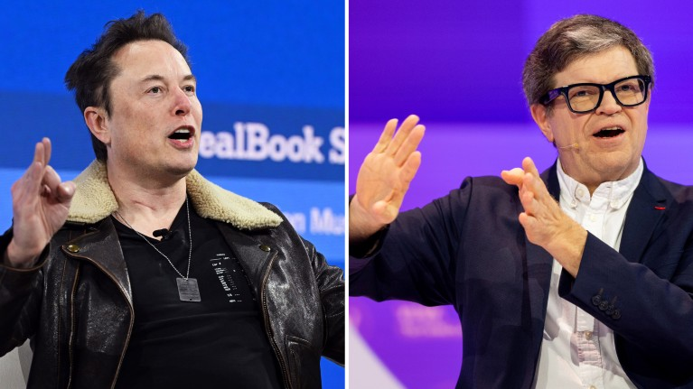
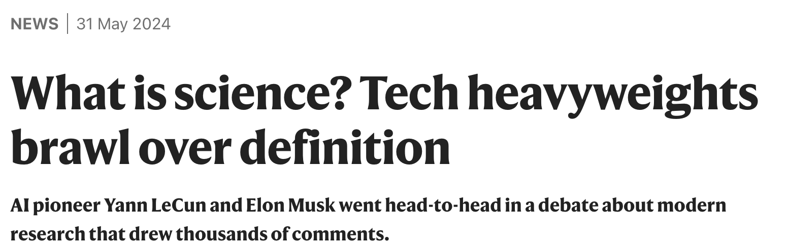

Slide 22
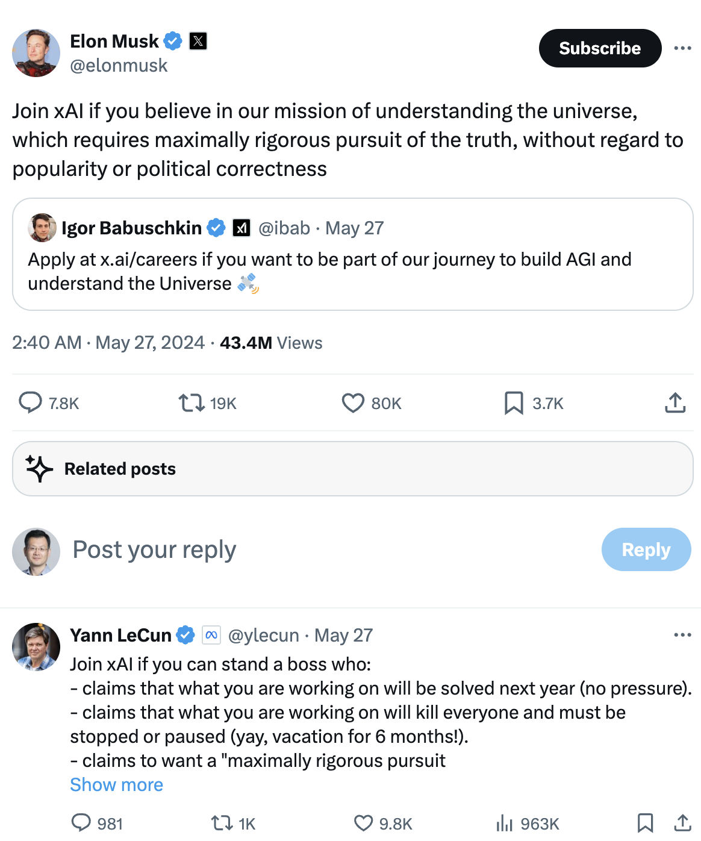
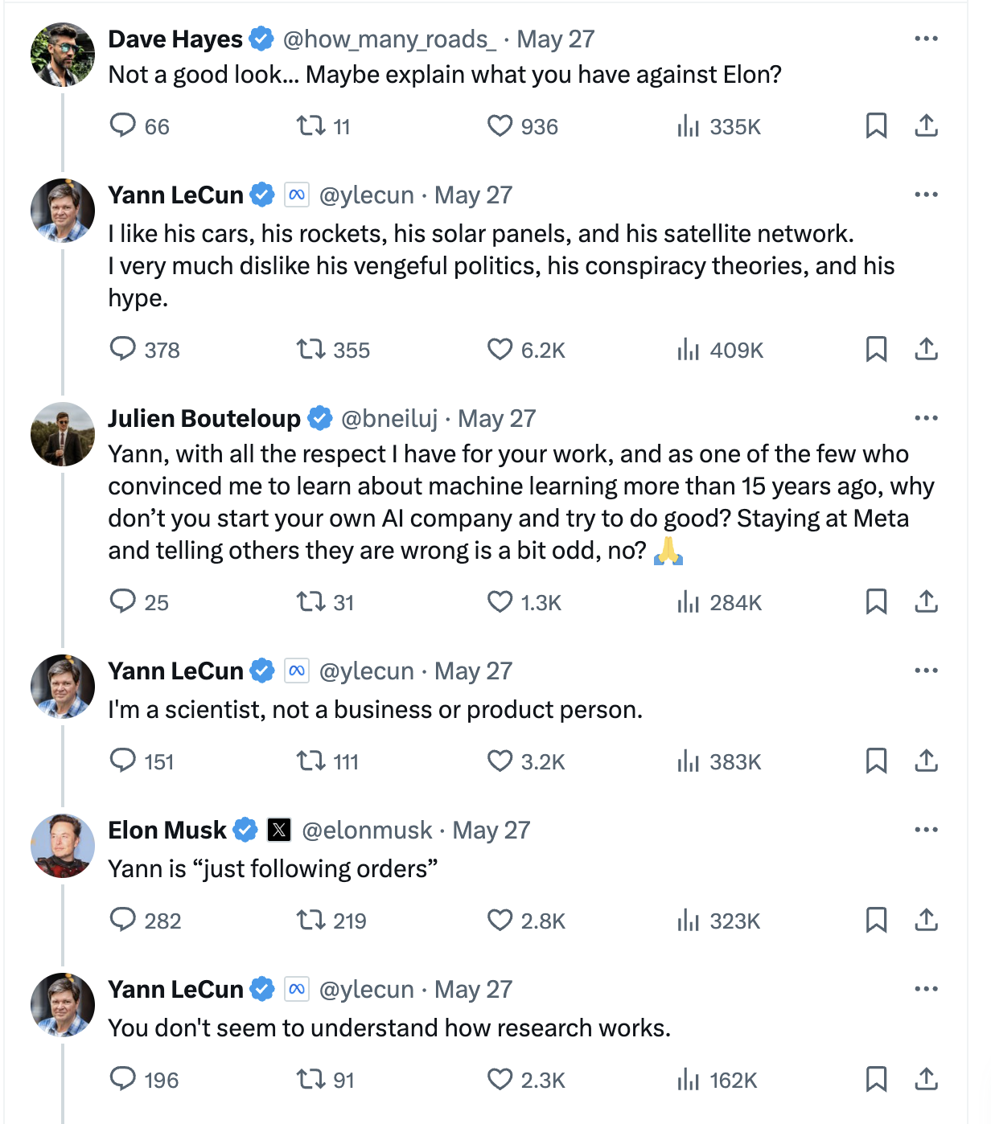

Slide 23
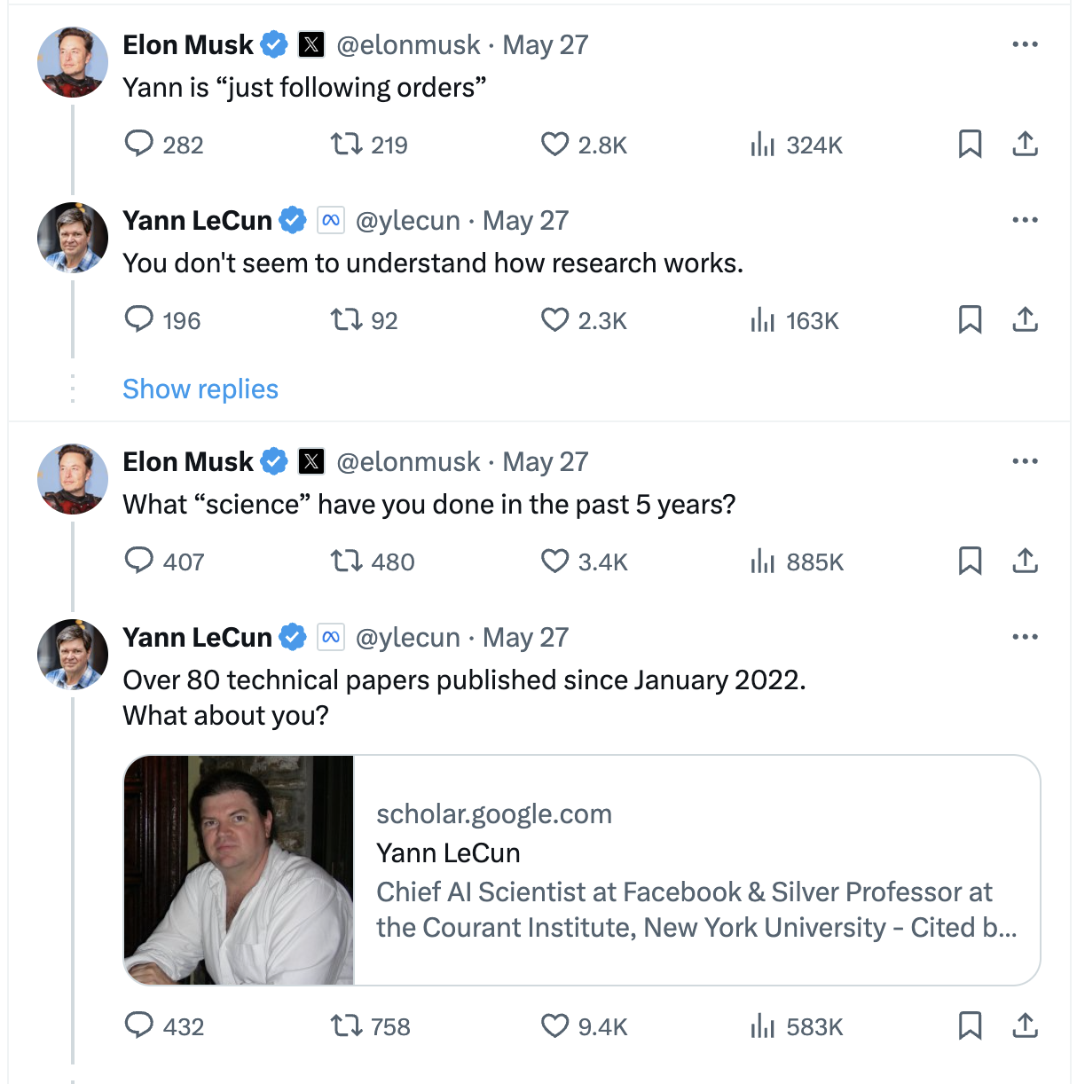
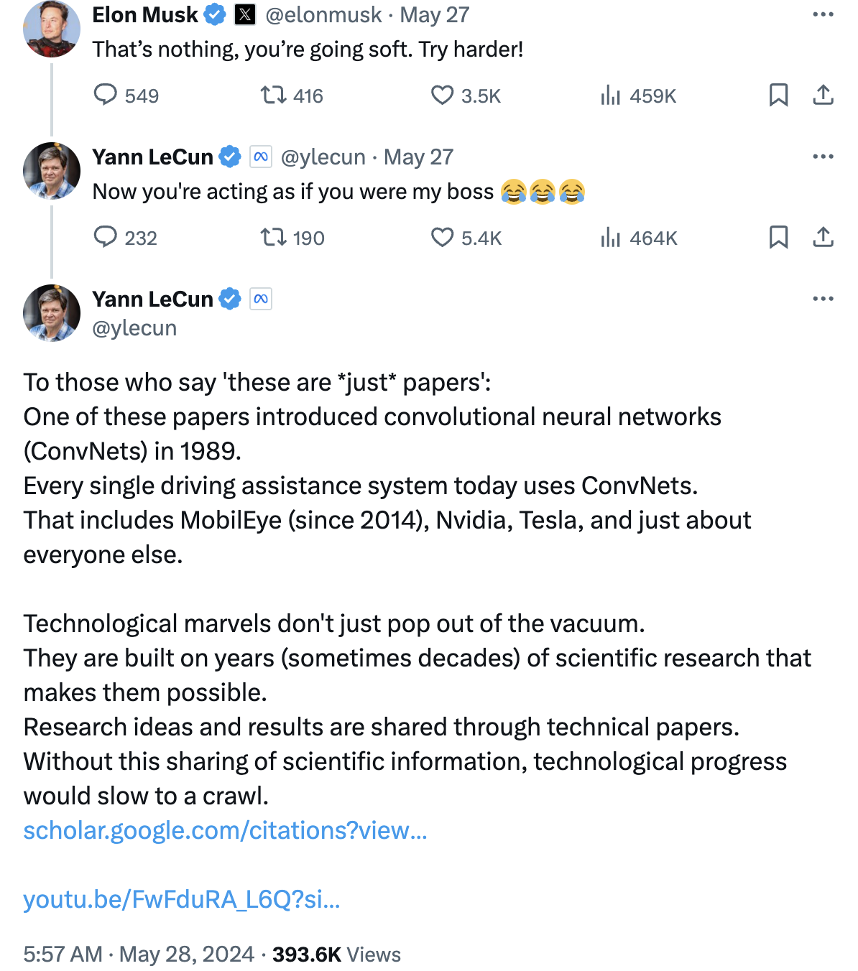

Slide 24
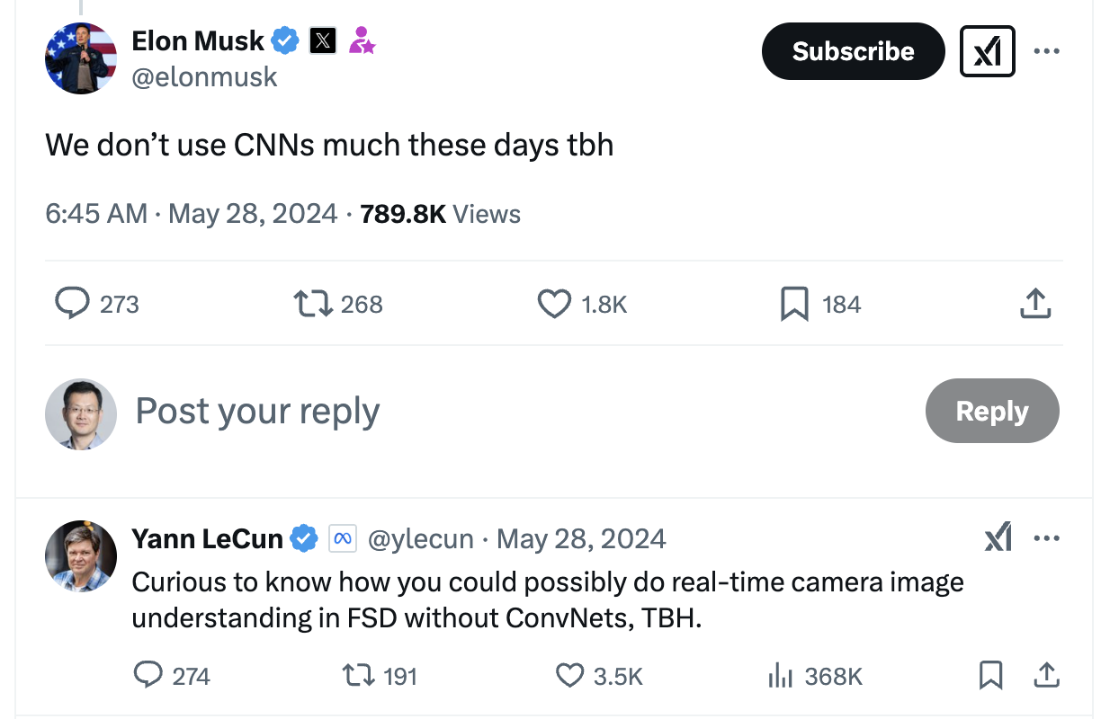

Slide 25
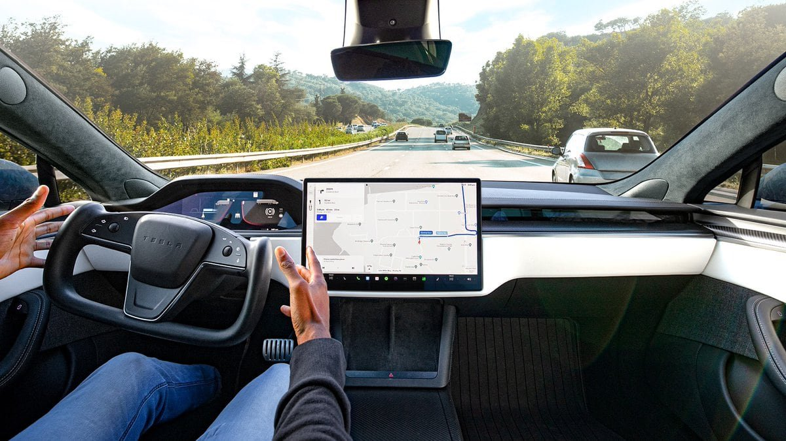

Slide 26
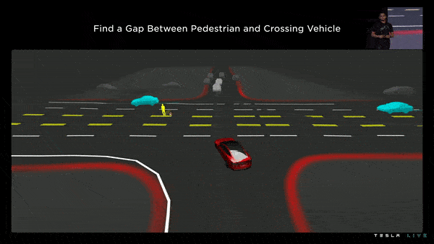
Before 2022:
In this example, the vehicle has to:
Yield to the pedestrian crossing illegally
Yield to the car coming from the right
Step 1: We start with the vision measurements (lanes, objects, and occupancy)
Step 2-3: We then generate goal candidates and trajectories
Step 4: We evaluate the first choice: pedestrian yield vs assert
Step 5: We evaluate the second choice: Right car yield vs assert
https://www.thinkautonomous.ai/blog/tesla-end-to-end-deep-learning/
Notes:
SD Beta V12 upgrades the city-streets driving stack to a single end-to-end neural network trained on millions of video clips, replacing over 300k lines of explicit C++ code."

Slide 27
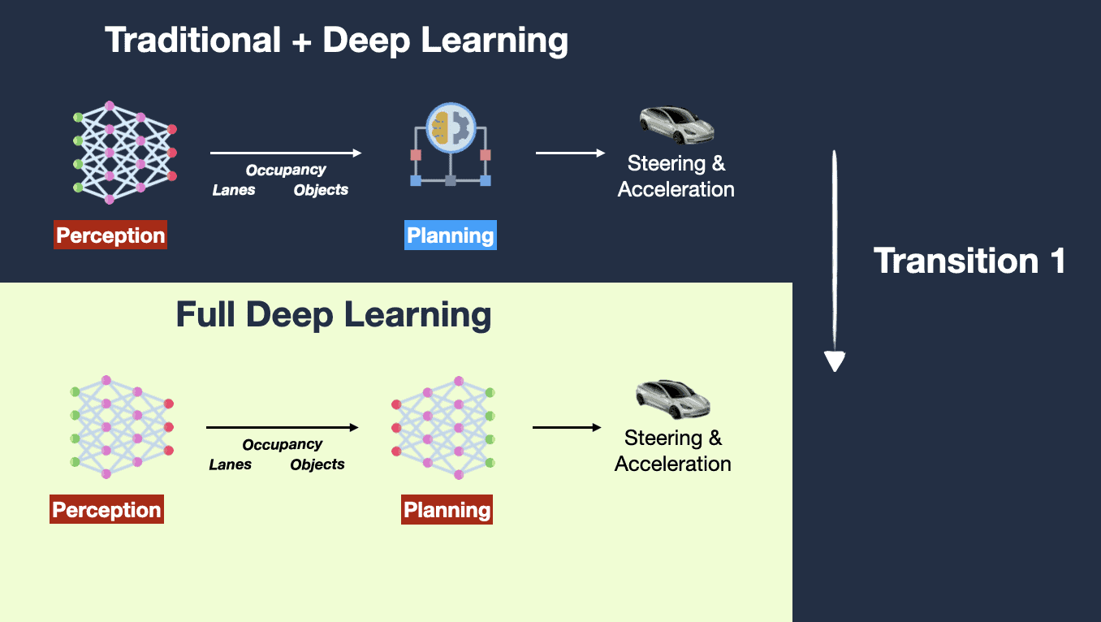
2022/2023

Slide 28
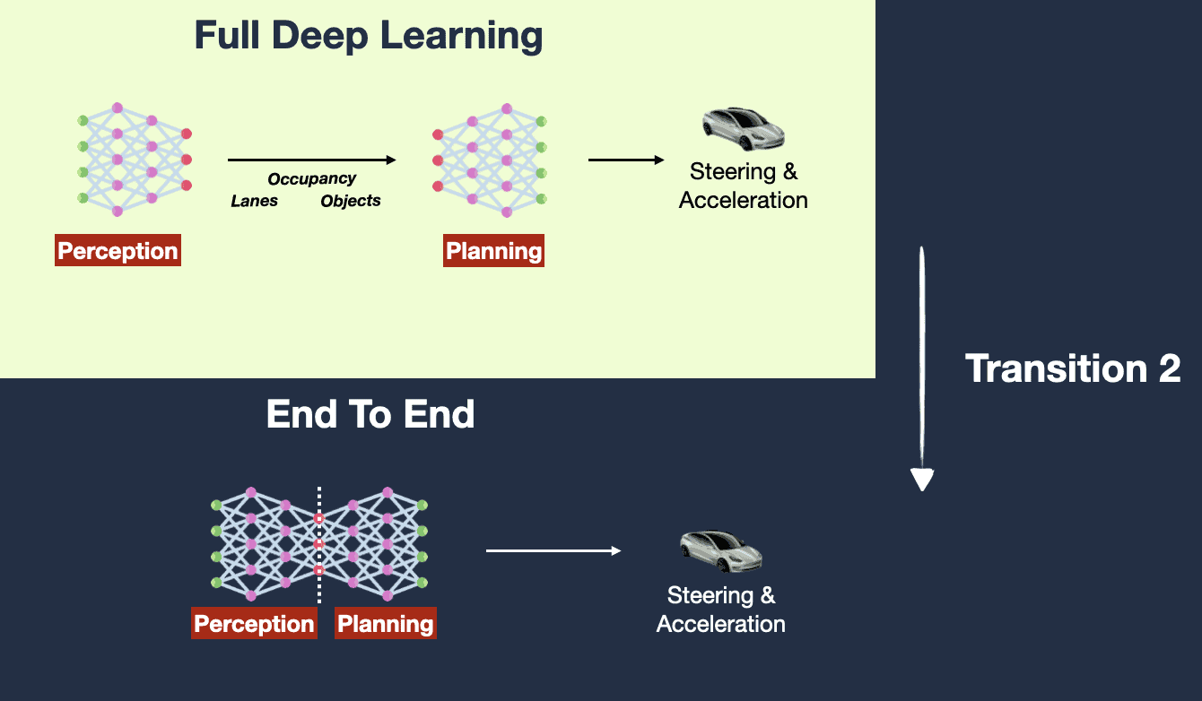
2023/2024
Notes:
December 2022, Tesla Headquarters, Palo Alto... During a meeting, an Autopilot Engineer named Dhaval Shroff pitched a new idea to Elon Musk:
💡
"It's like Chat-GPT, but for cars!!!" "Instead of determining the proper path of the car based on rules, we determine the car's proper path by using neural network that learns from millions of training examples of what humans have done."
Convinced, Elon Musk and the entire Autopilot team rushed into applying a new algorithm to the next FSD Version (from FSD v11 to FSD v12).
And that was the beginning of End-To-End Learning at Tesla...

Slide 29
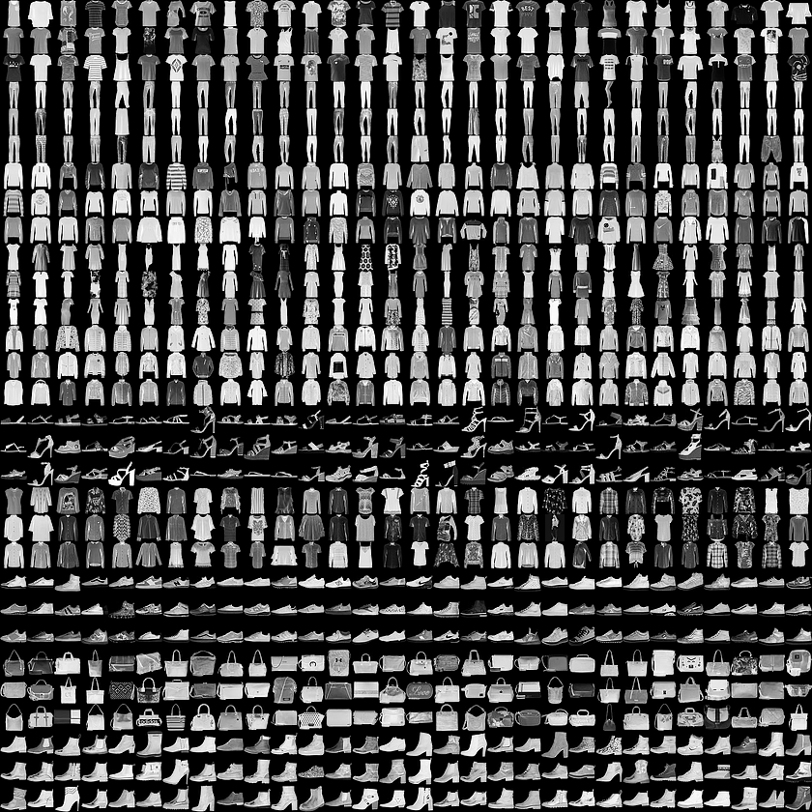
Application
Fashion goods classification
Also learn two important concepts:
Overfitting
Dropout
First, let's use the vanilla feed forward neural network
Simple_neural_network_for_fashion.ipynbLinks to an external site.
Then, let's use a CNN model -- does it perform better? What issues do you see?
CNN_for_fashion_CNN_no_dropout.ipynbLinks to an external site.
We will try adding dropout and see whether it helps.
CNN_for_fashion_with_dropout.ipynbLinks to an external site.
(Optional) let's try CNN on COVID detection based on X-ray images:

Slide 30
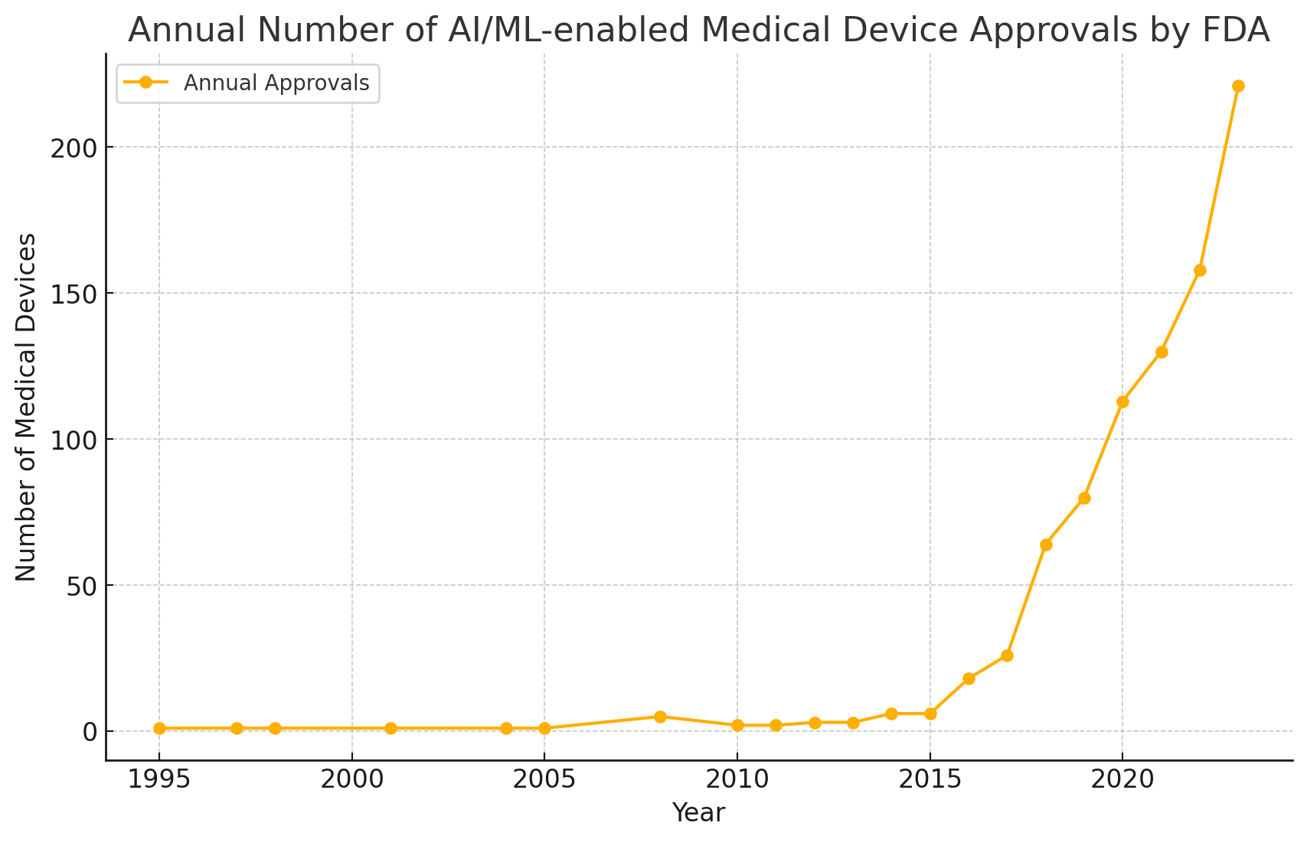
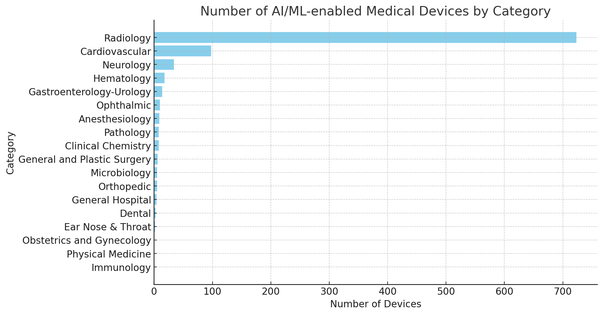
Assignment: AI/ML-enabled devices by year of FDA decision date
Data source: https://www.fda.gov/medical-devices/software-medical-device-samd/artificial-intelligence-and-machine-learning-aiml-enabled-medical-devices
Notes:
https://www.fda.gov/medical-devices/software-medical-device-samd/artificial-intelligence-and-machine-learning-aiml-enabled-medical-devices
Panch, Trishan, Erin Duralde, Heather Mattie, Gopal Kotecha, Leo Anthony Celi, Melanie Wright, and Felix Greaves. “A Distributed Approach to the Regulation of Clinical AI.” Edited by Henry Horng-Shing Lu. PLOS Digital Health 1, no. 5 (May 26, 2022): e0000040. https://doi.org/10.1371/journal.pdig.0000040.

